Slide 1
Football Scouting with Code
Michał Stobiecki, Robert Matthews and Dylan Iteka

Slide 2
Problems and Goals
1
Find Data and Estimated Value of Players
Scrape Data from transfermarkt.com
2
Get a Visual Idea of the Data Set
Visualisation of the vast player set across countries and leagues
3
Match Players with Similar Profiles
Unsupervised learning to find cheaper versions of the same players
4
Verify Transfermarkt Valuation
Supervised learning to compare playing data and valuation

Slide 3
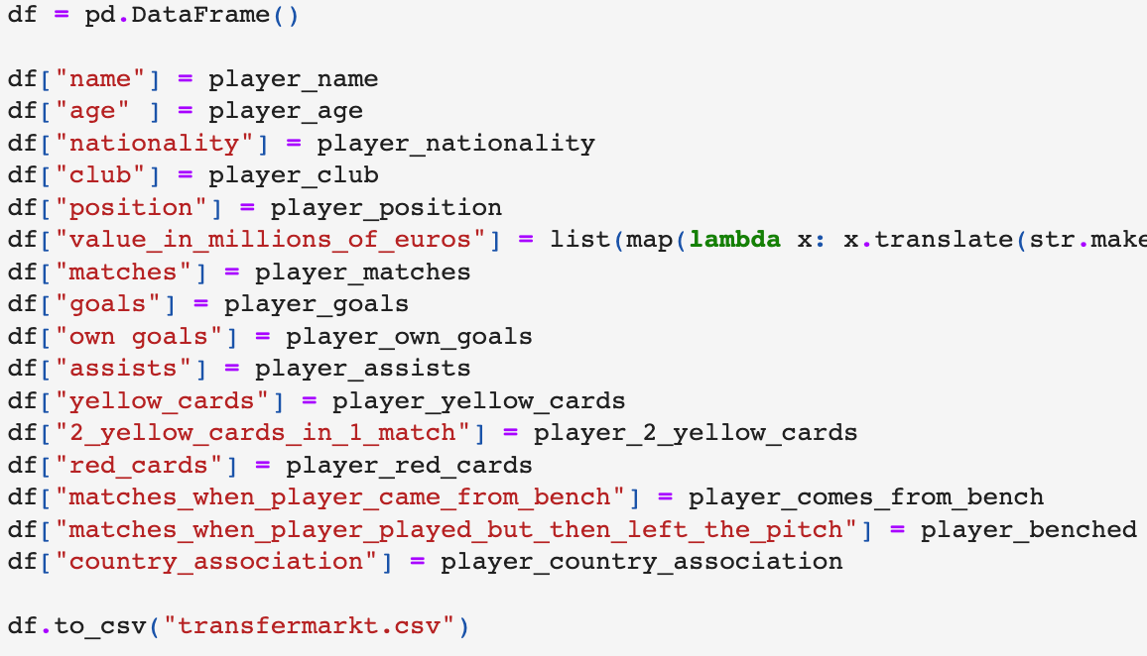
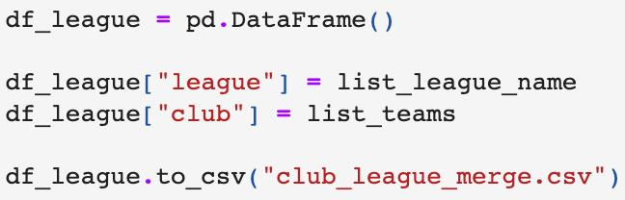
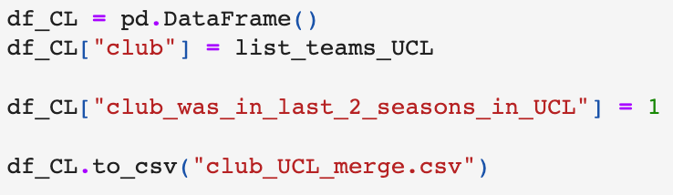
Scraping
Various leagues and club names
Playing data about players and valuation
Champions league club names

Slide 4
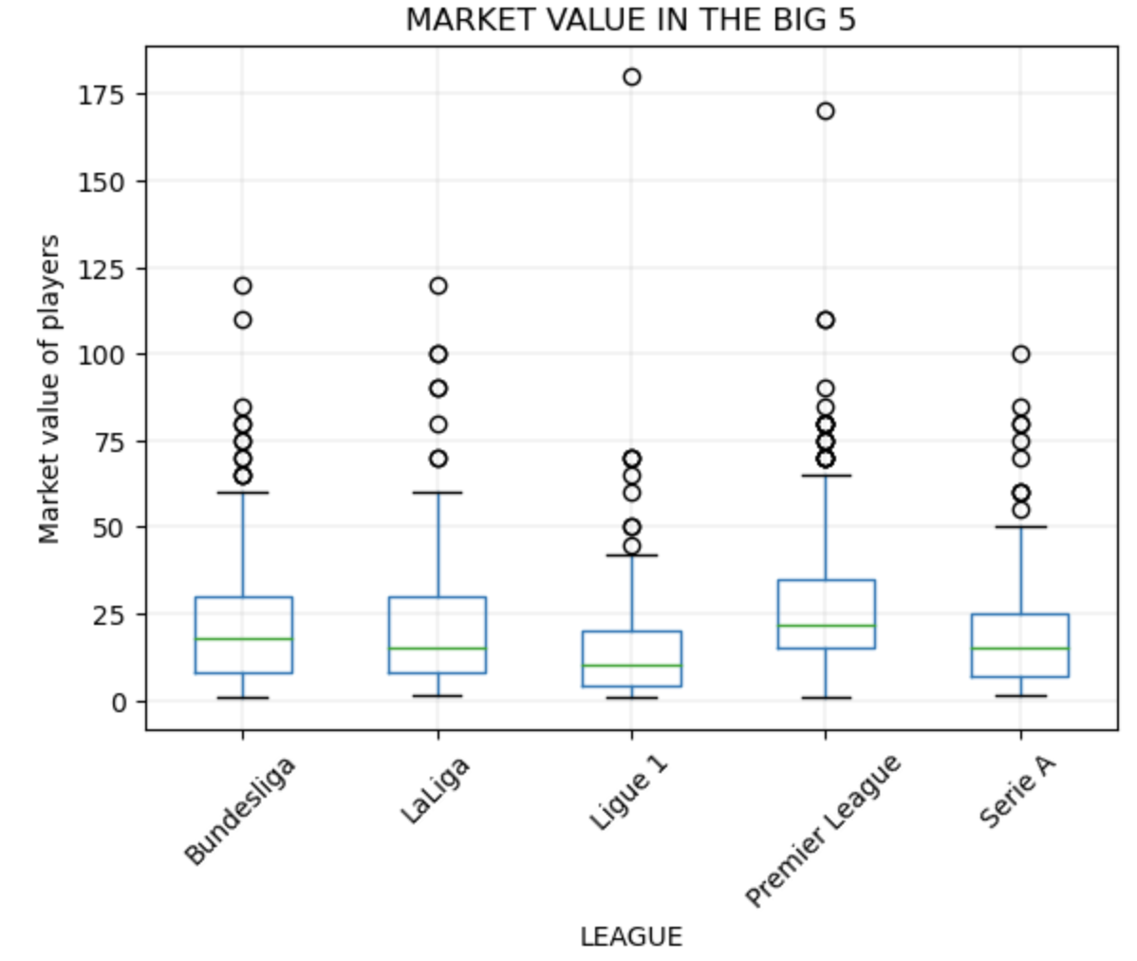
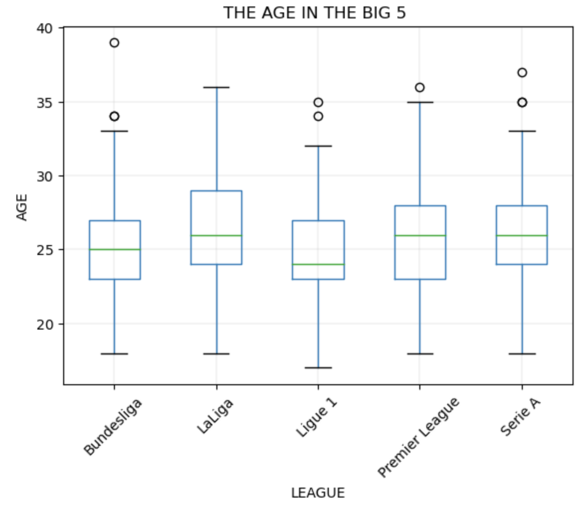
Visualisation by Leagues (pt. 1)

Slide 5
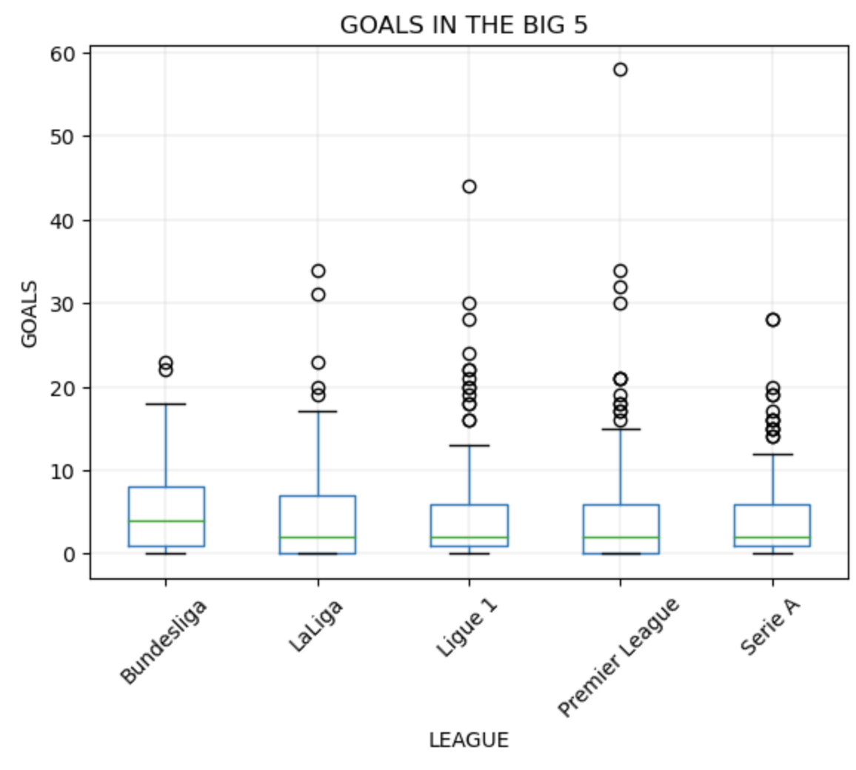
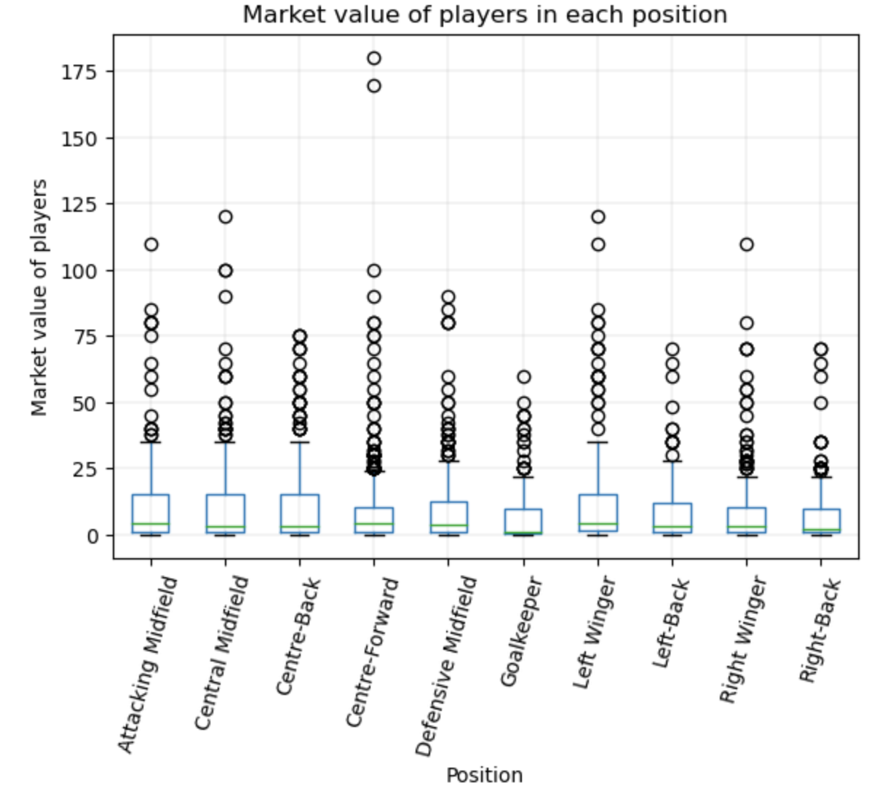
Visualisation by Leagues (pt. 2)

Slide 6
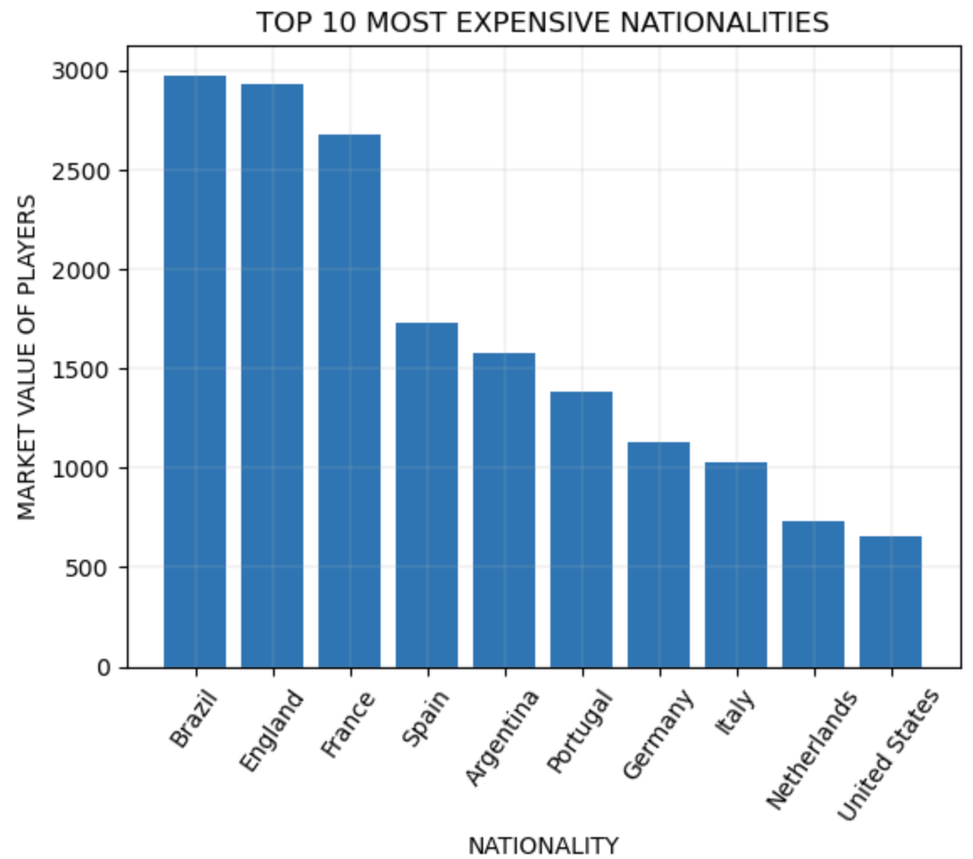
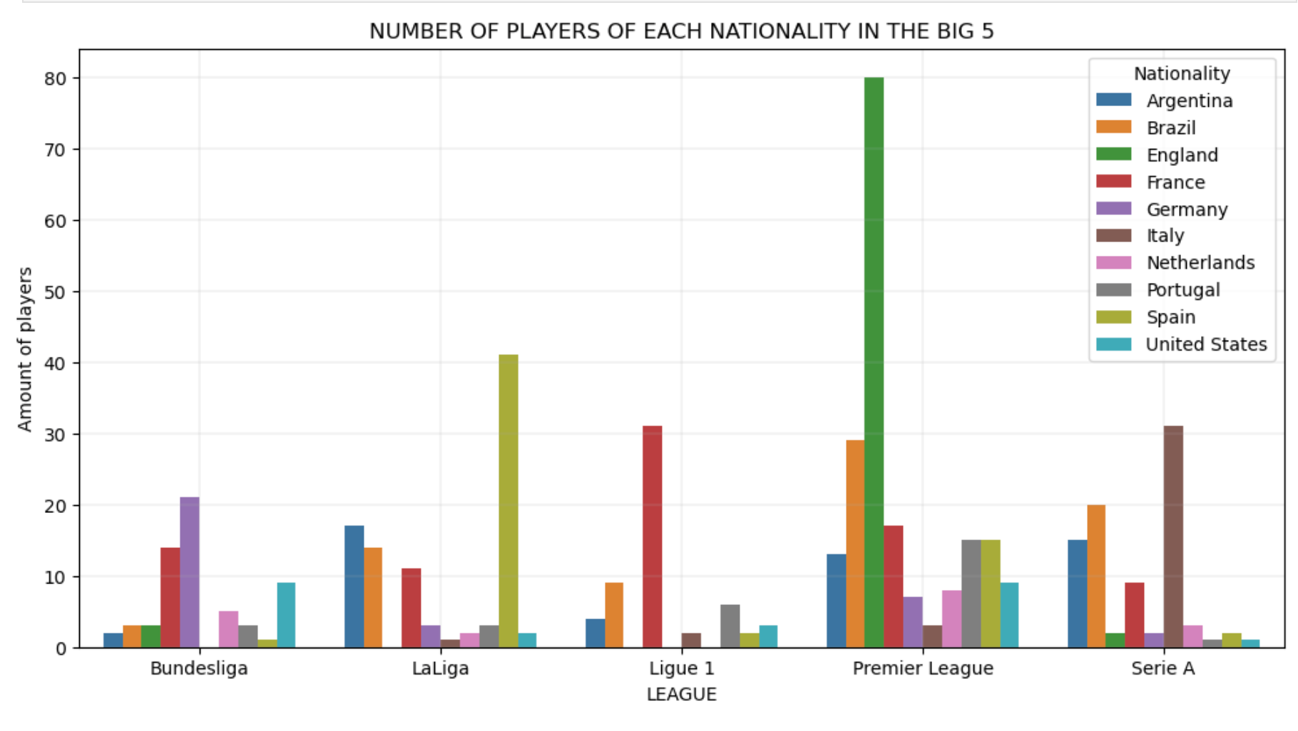
Visualisation by Nationality

Slide 7
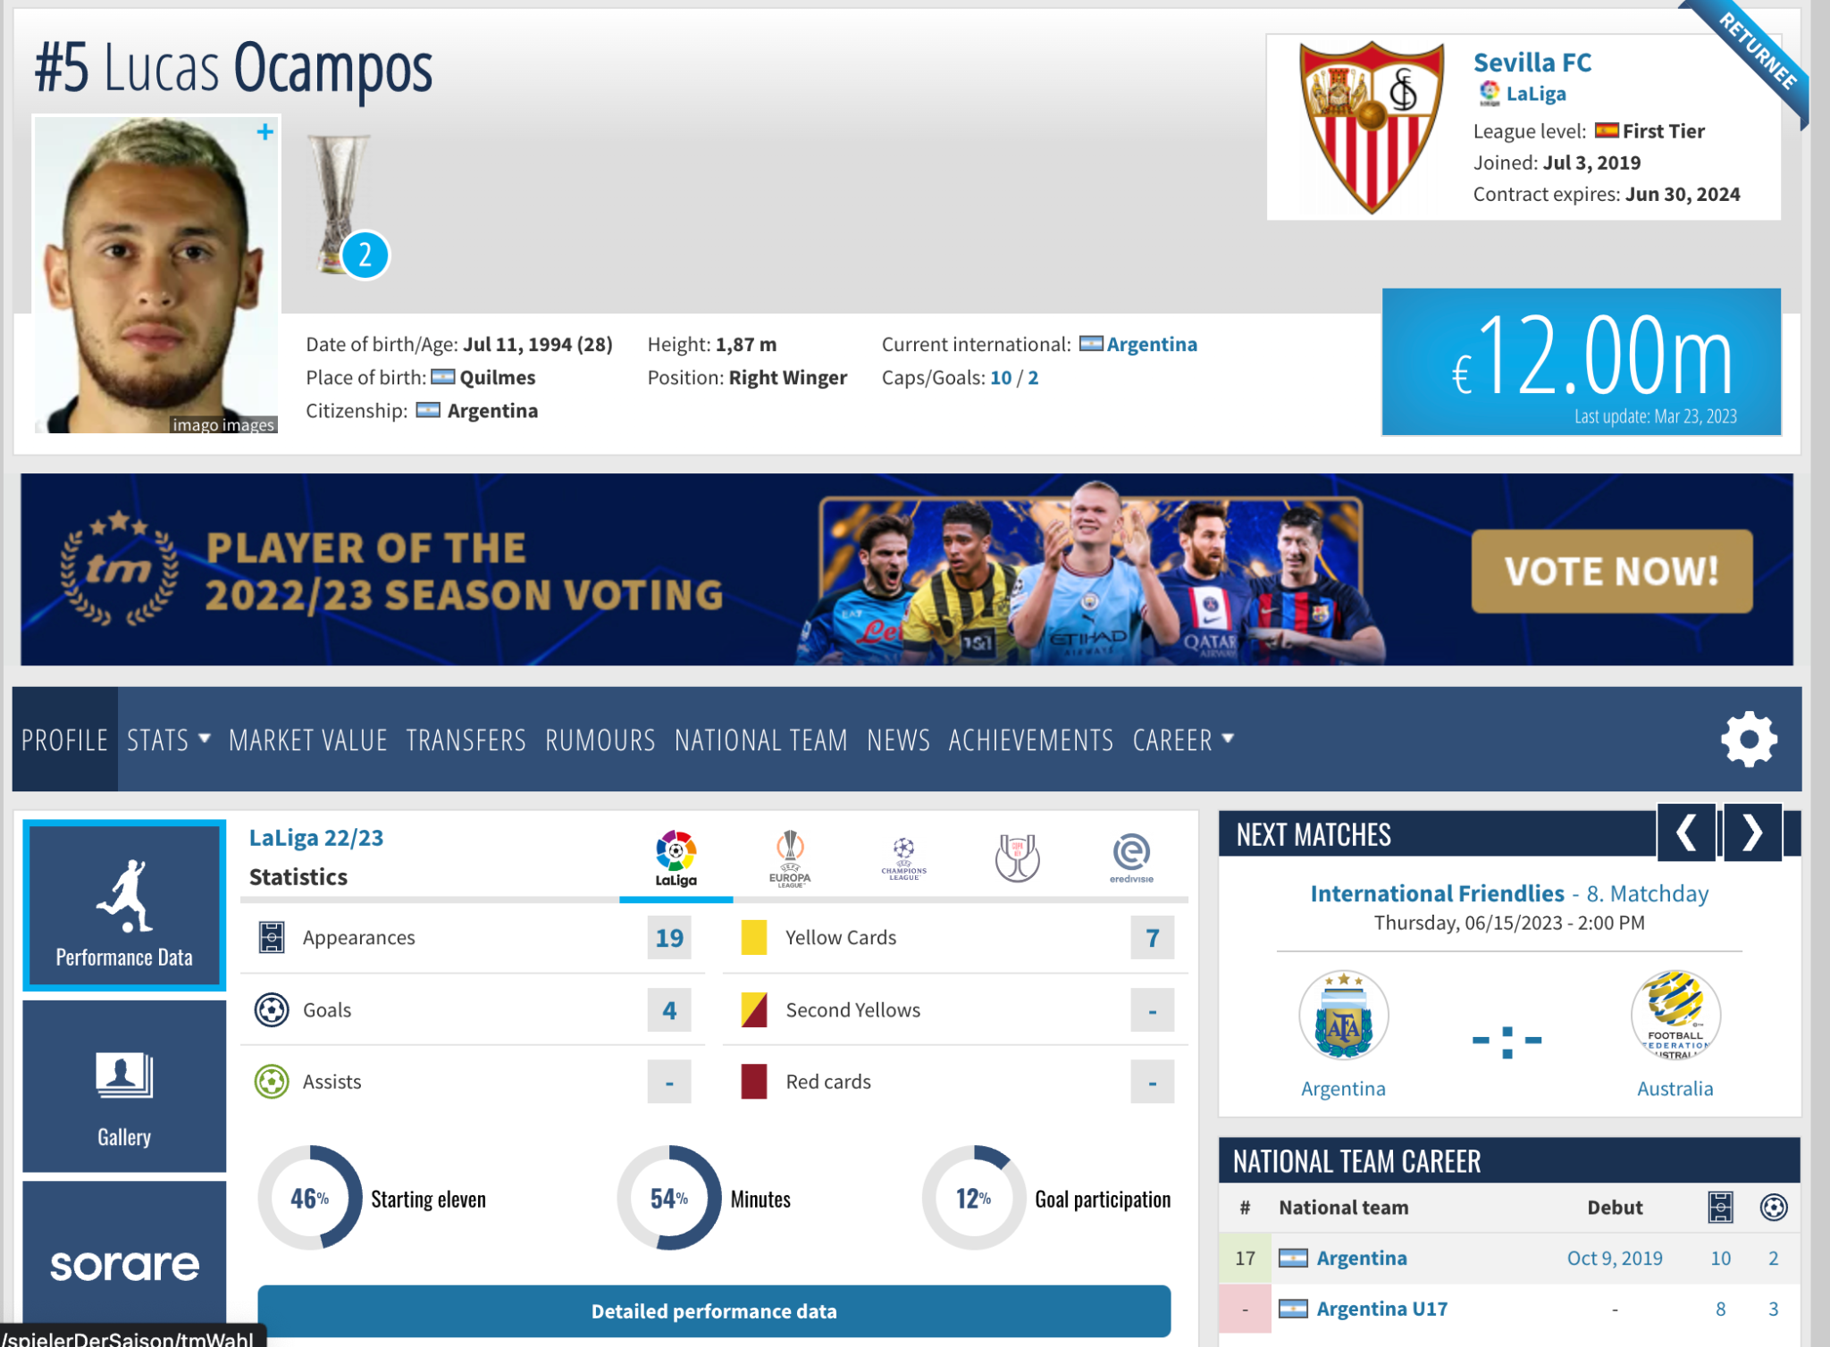
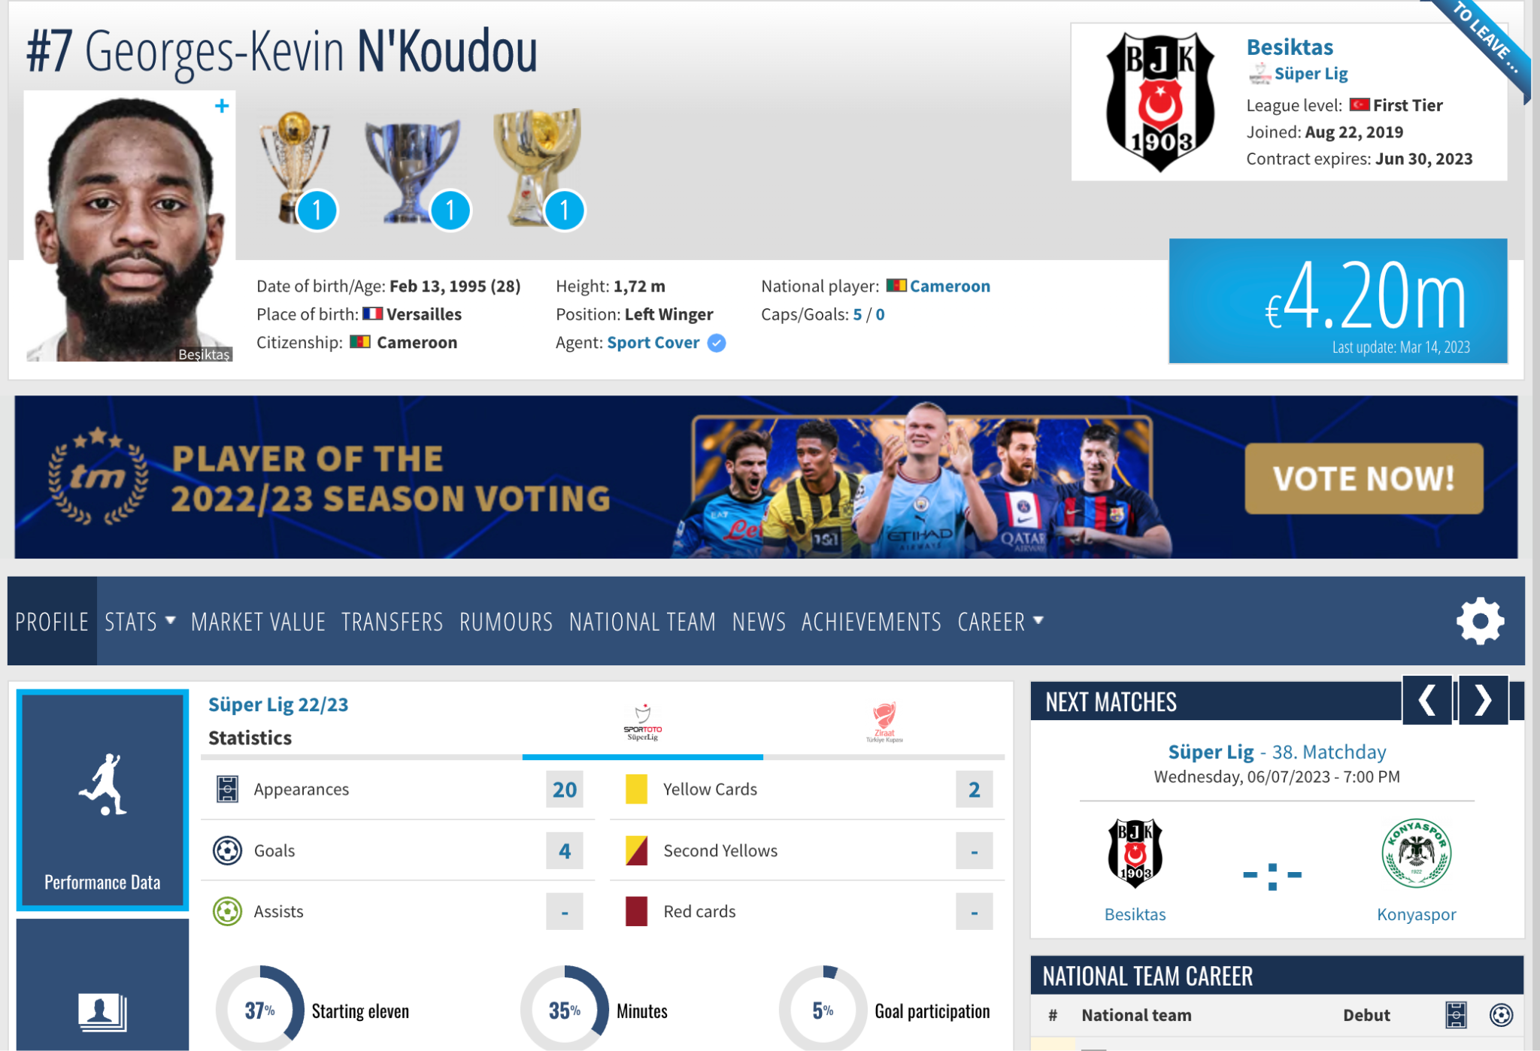
Unsupervised Learning to Link Similar Players
Stats used:
"matches", "goals", "assists", "goals_per_match", "assists_per_match", "age"
Condition:
Playing in UCL club
19 matches
4 goals
28 years
20 matches
4 goals
28 years
Better value?

Slide 8
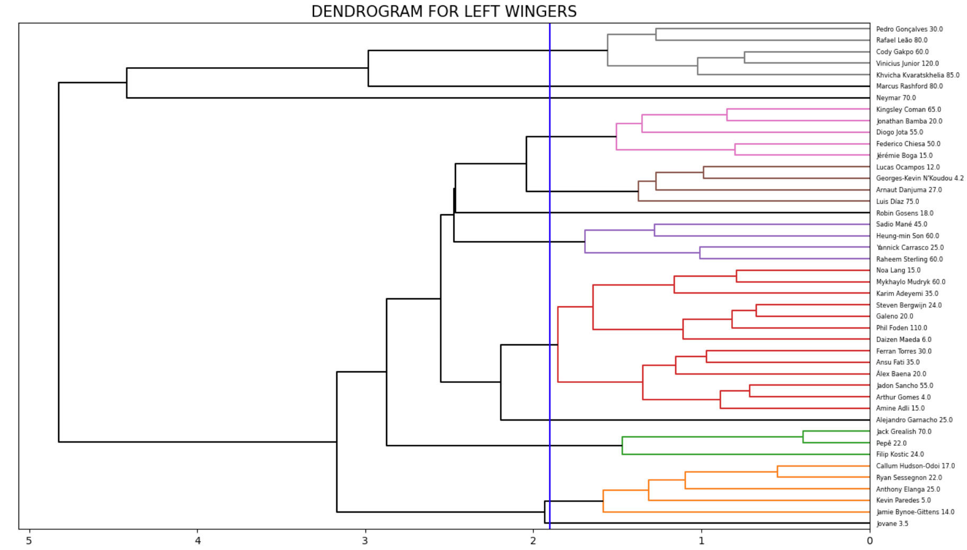

Slide 9
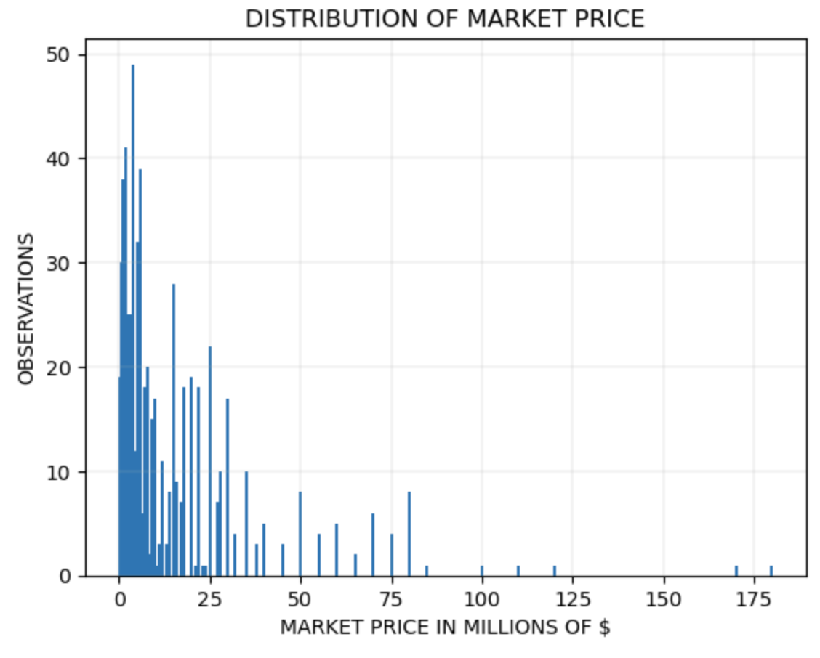
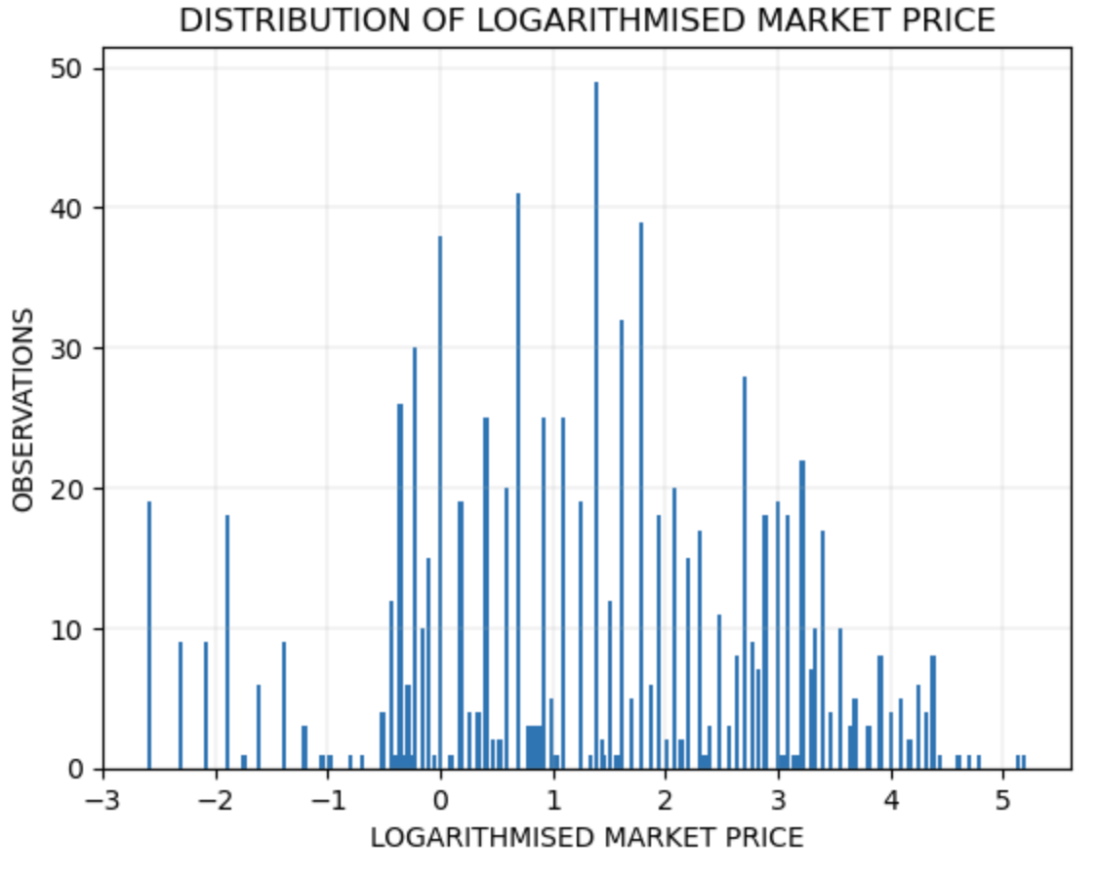
Supervised Learning - Distribution (Log?)

Slide 10
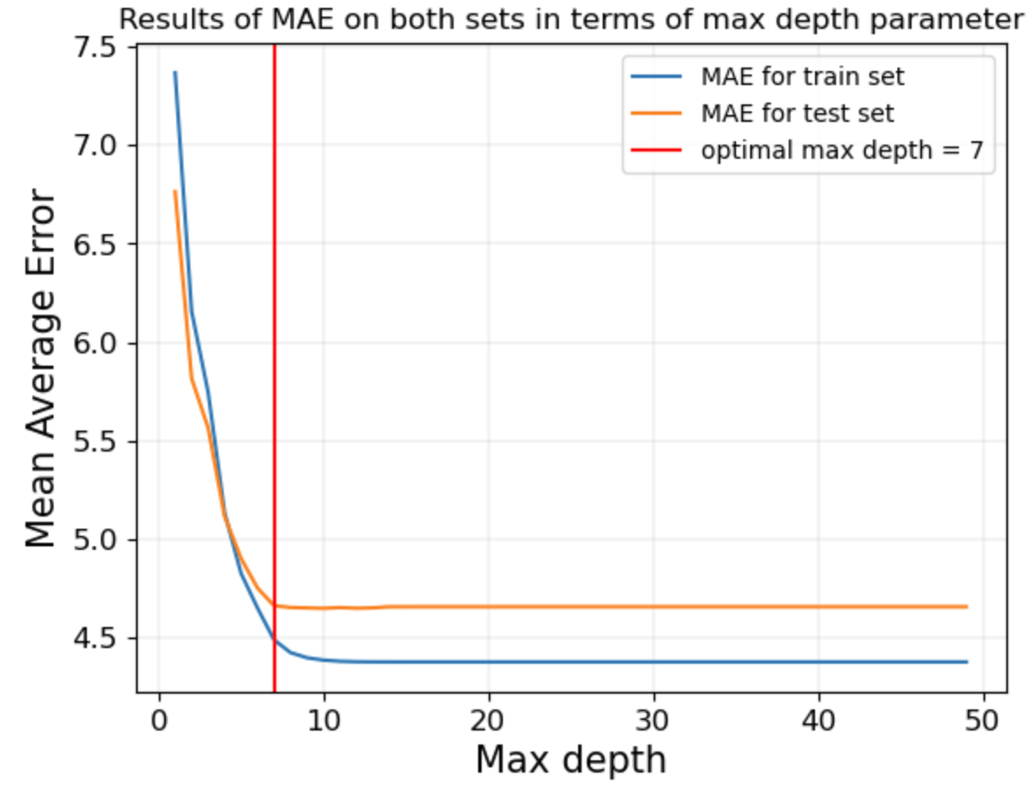
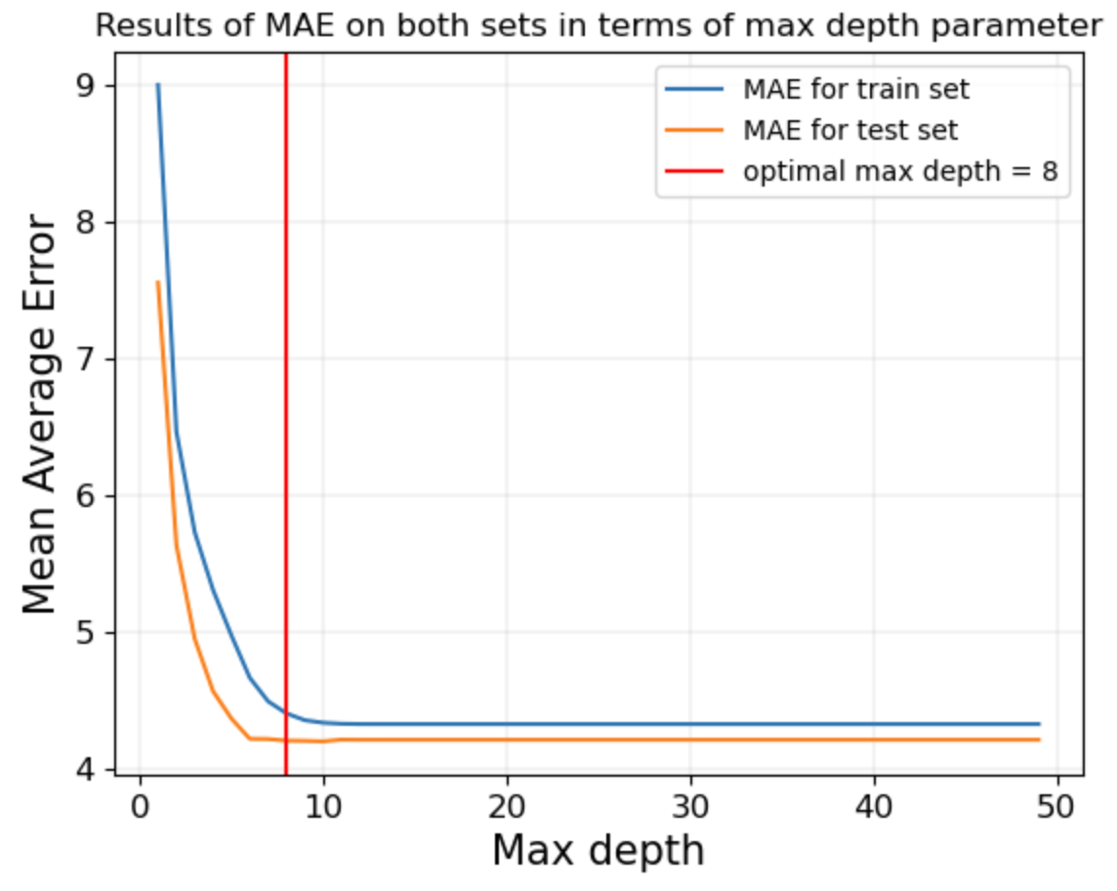
Distribution without changes vs logarithmised distribution
MAE on train set is equal to 4.49
MAE on test set is equal to 4.66
MAE on train set is equal to 4.41
MAE on test set is equal to 4.21
Logarithmic transformation improved quality of predictions.
The logarithmised distribution has lower MAE error on both sets.

Slide 11

Conclusions
Ballpark value estimations possible with ML
Potential to find bargains that are for some reason underpriced
Tool could be useful for big clubs to validate their search

